Slide 1
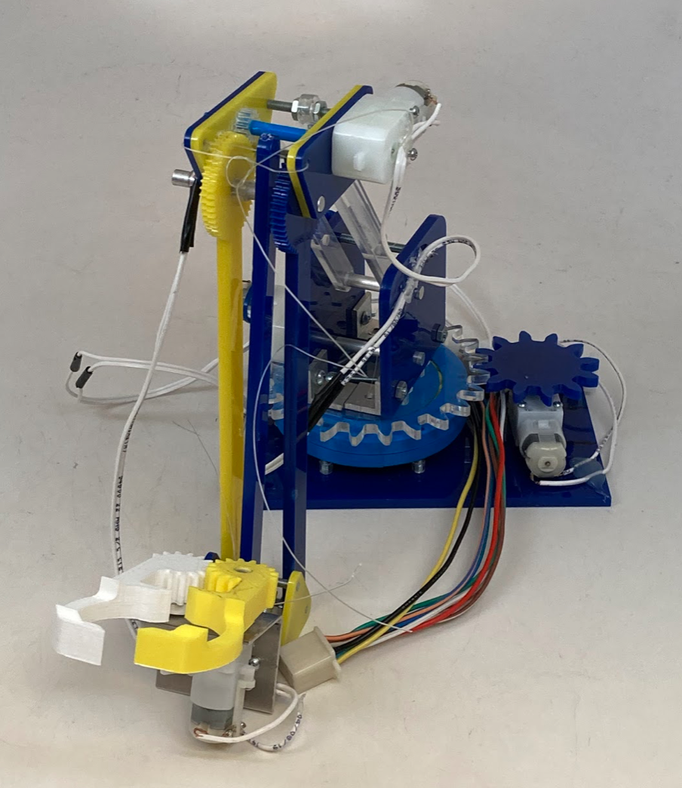
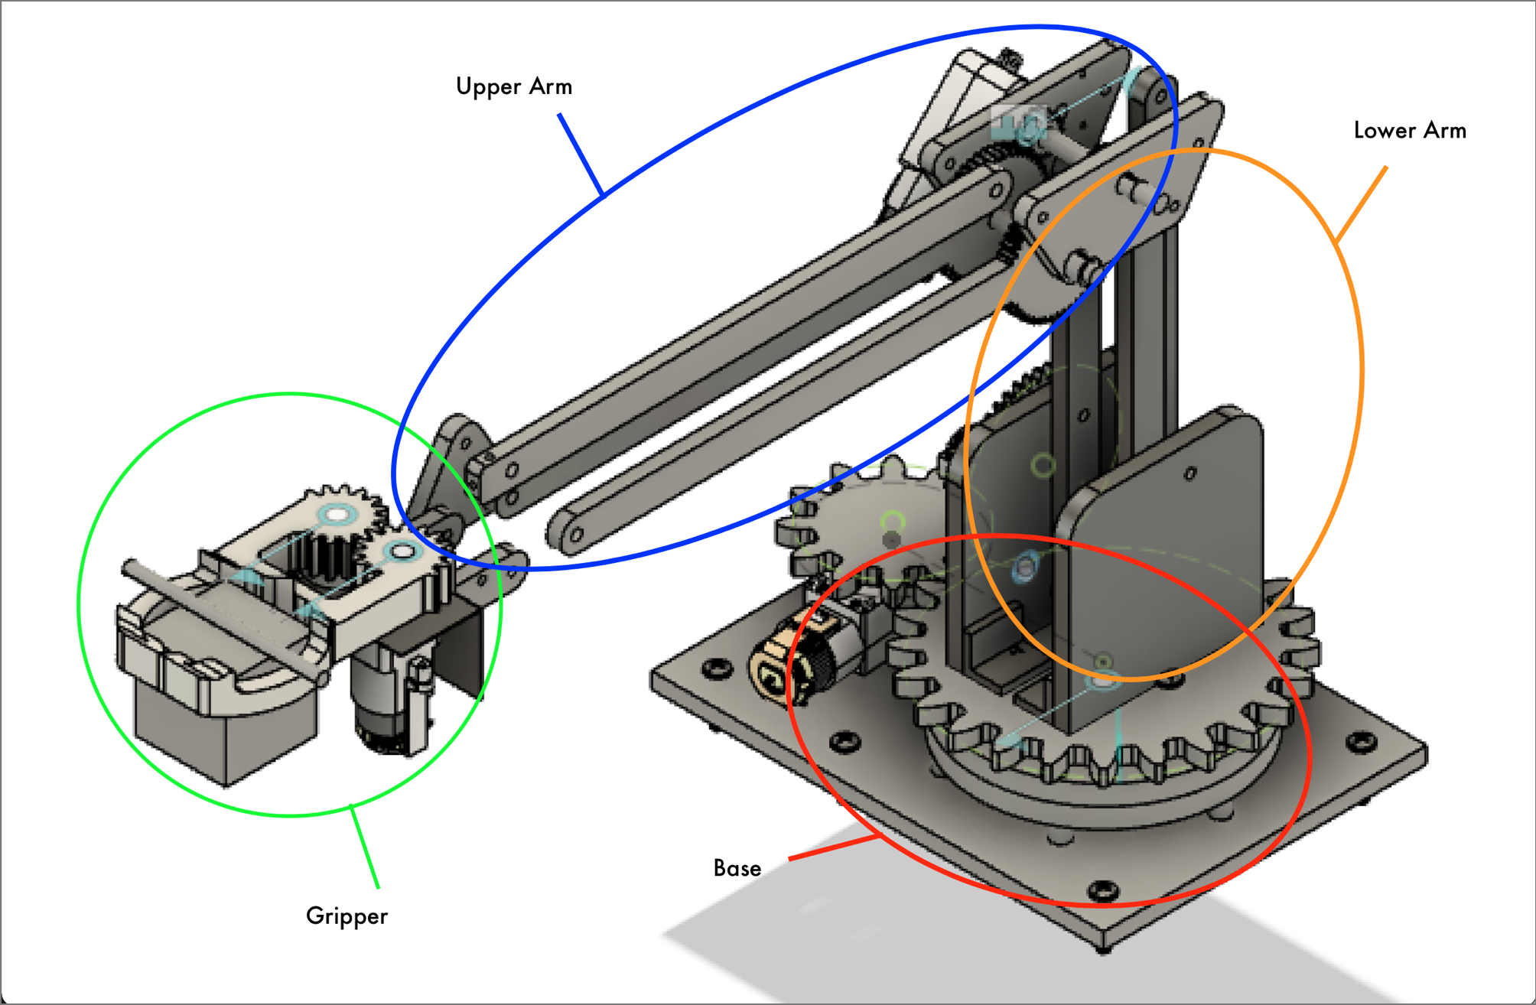
Team 20: Robotic Arm
Roger
Minh Luc, Nick Ratto, Hsi-ruei Tsao, Roger Nguyen

Slide 2
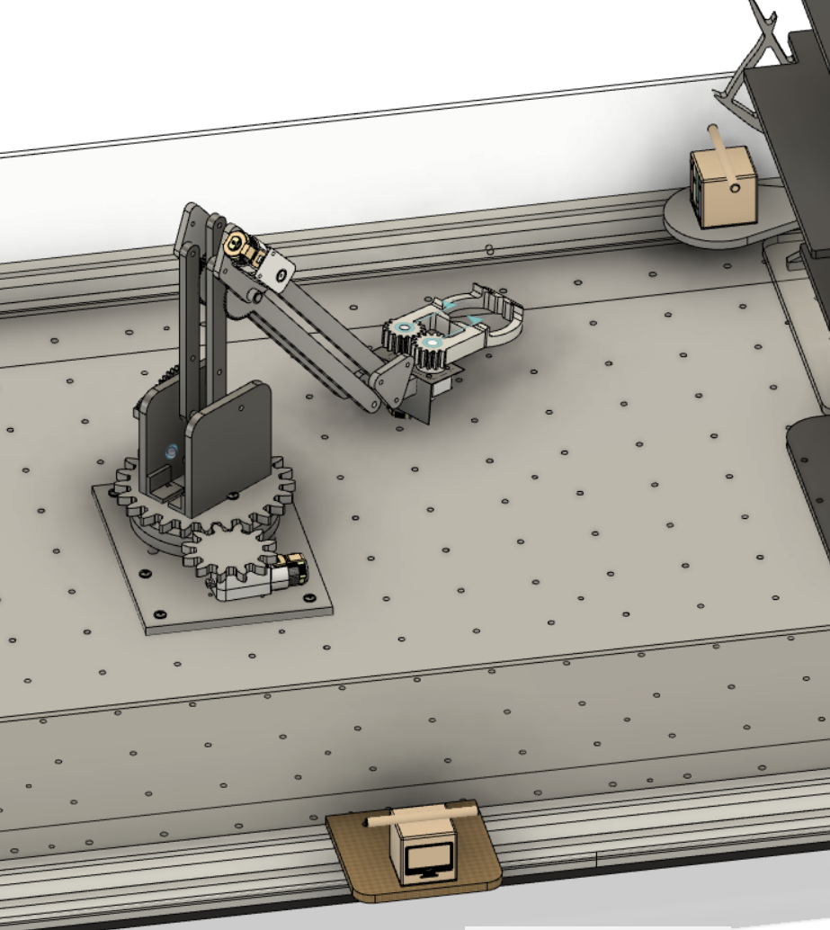
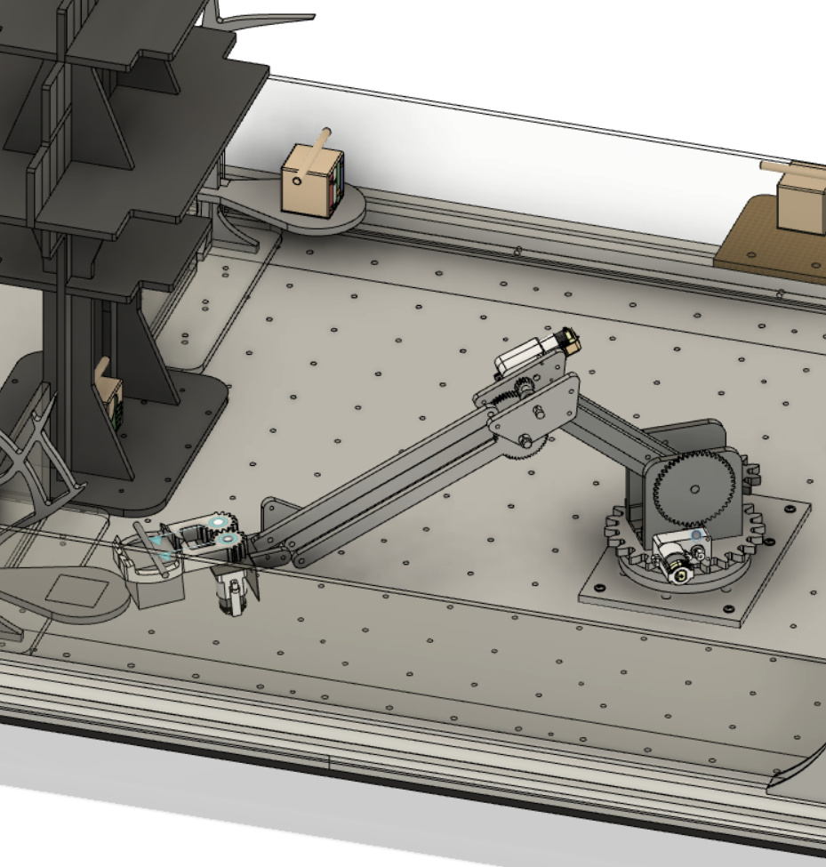
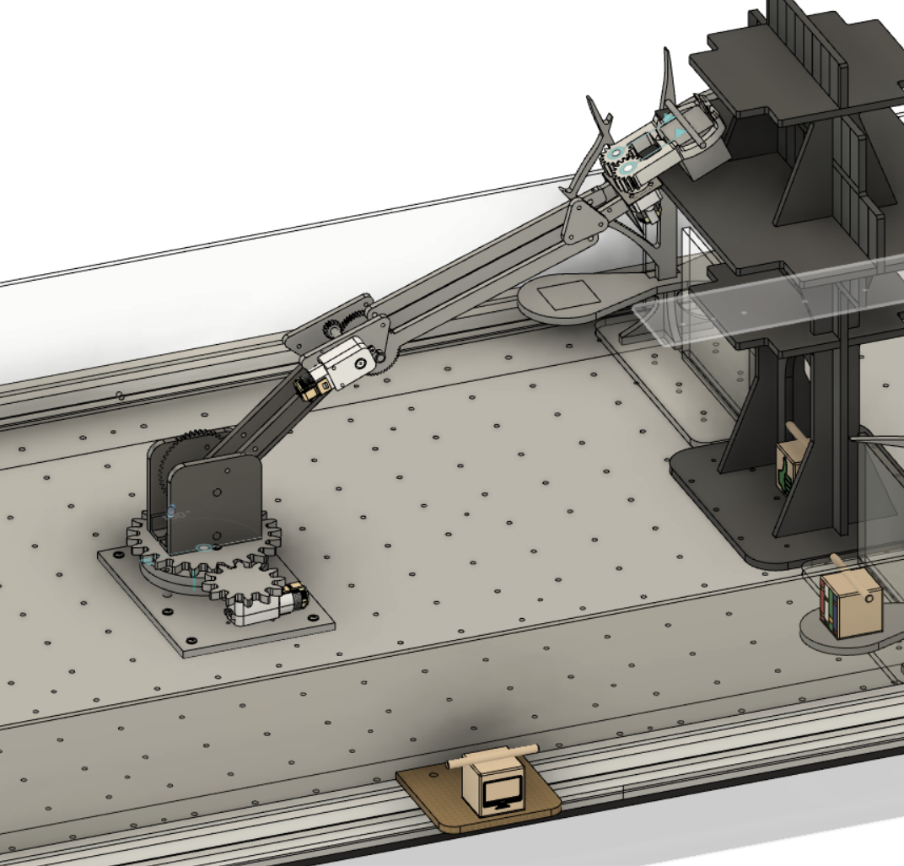
How Robot Arm Scores Points
Nick
CAD of Robot Collapsing
CAD of Robot Picking Up Box
CAD of Robot Dropping Box

Slide 3

Animation of Robot in Action
Bill

Slide 4
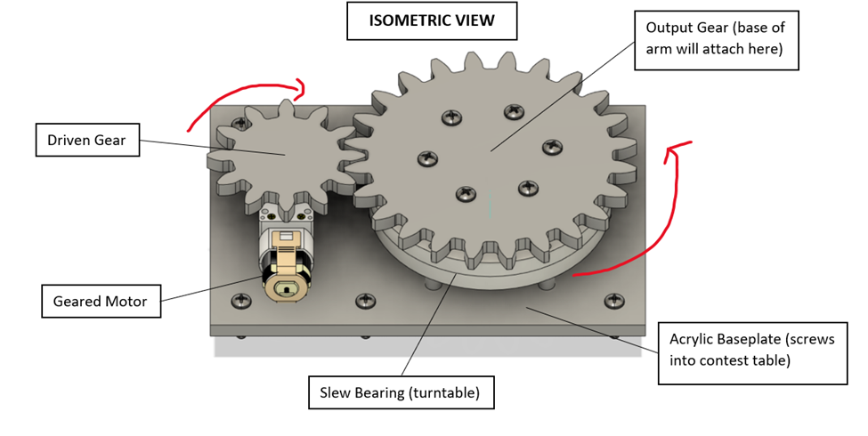
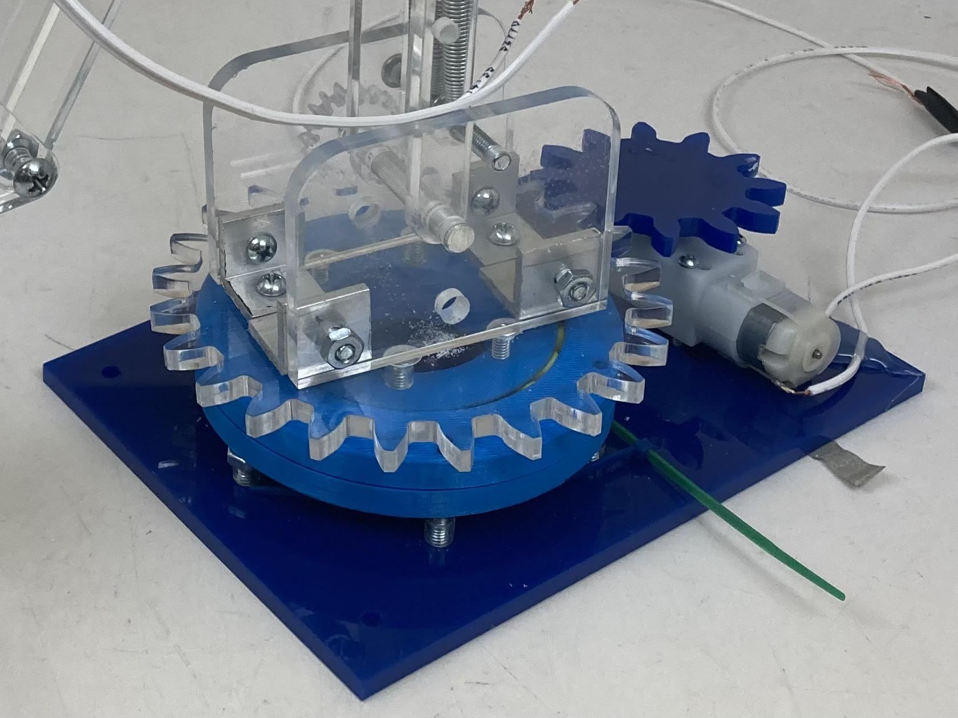
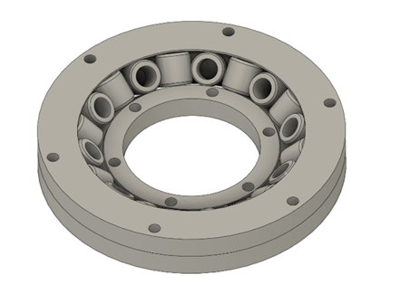
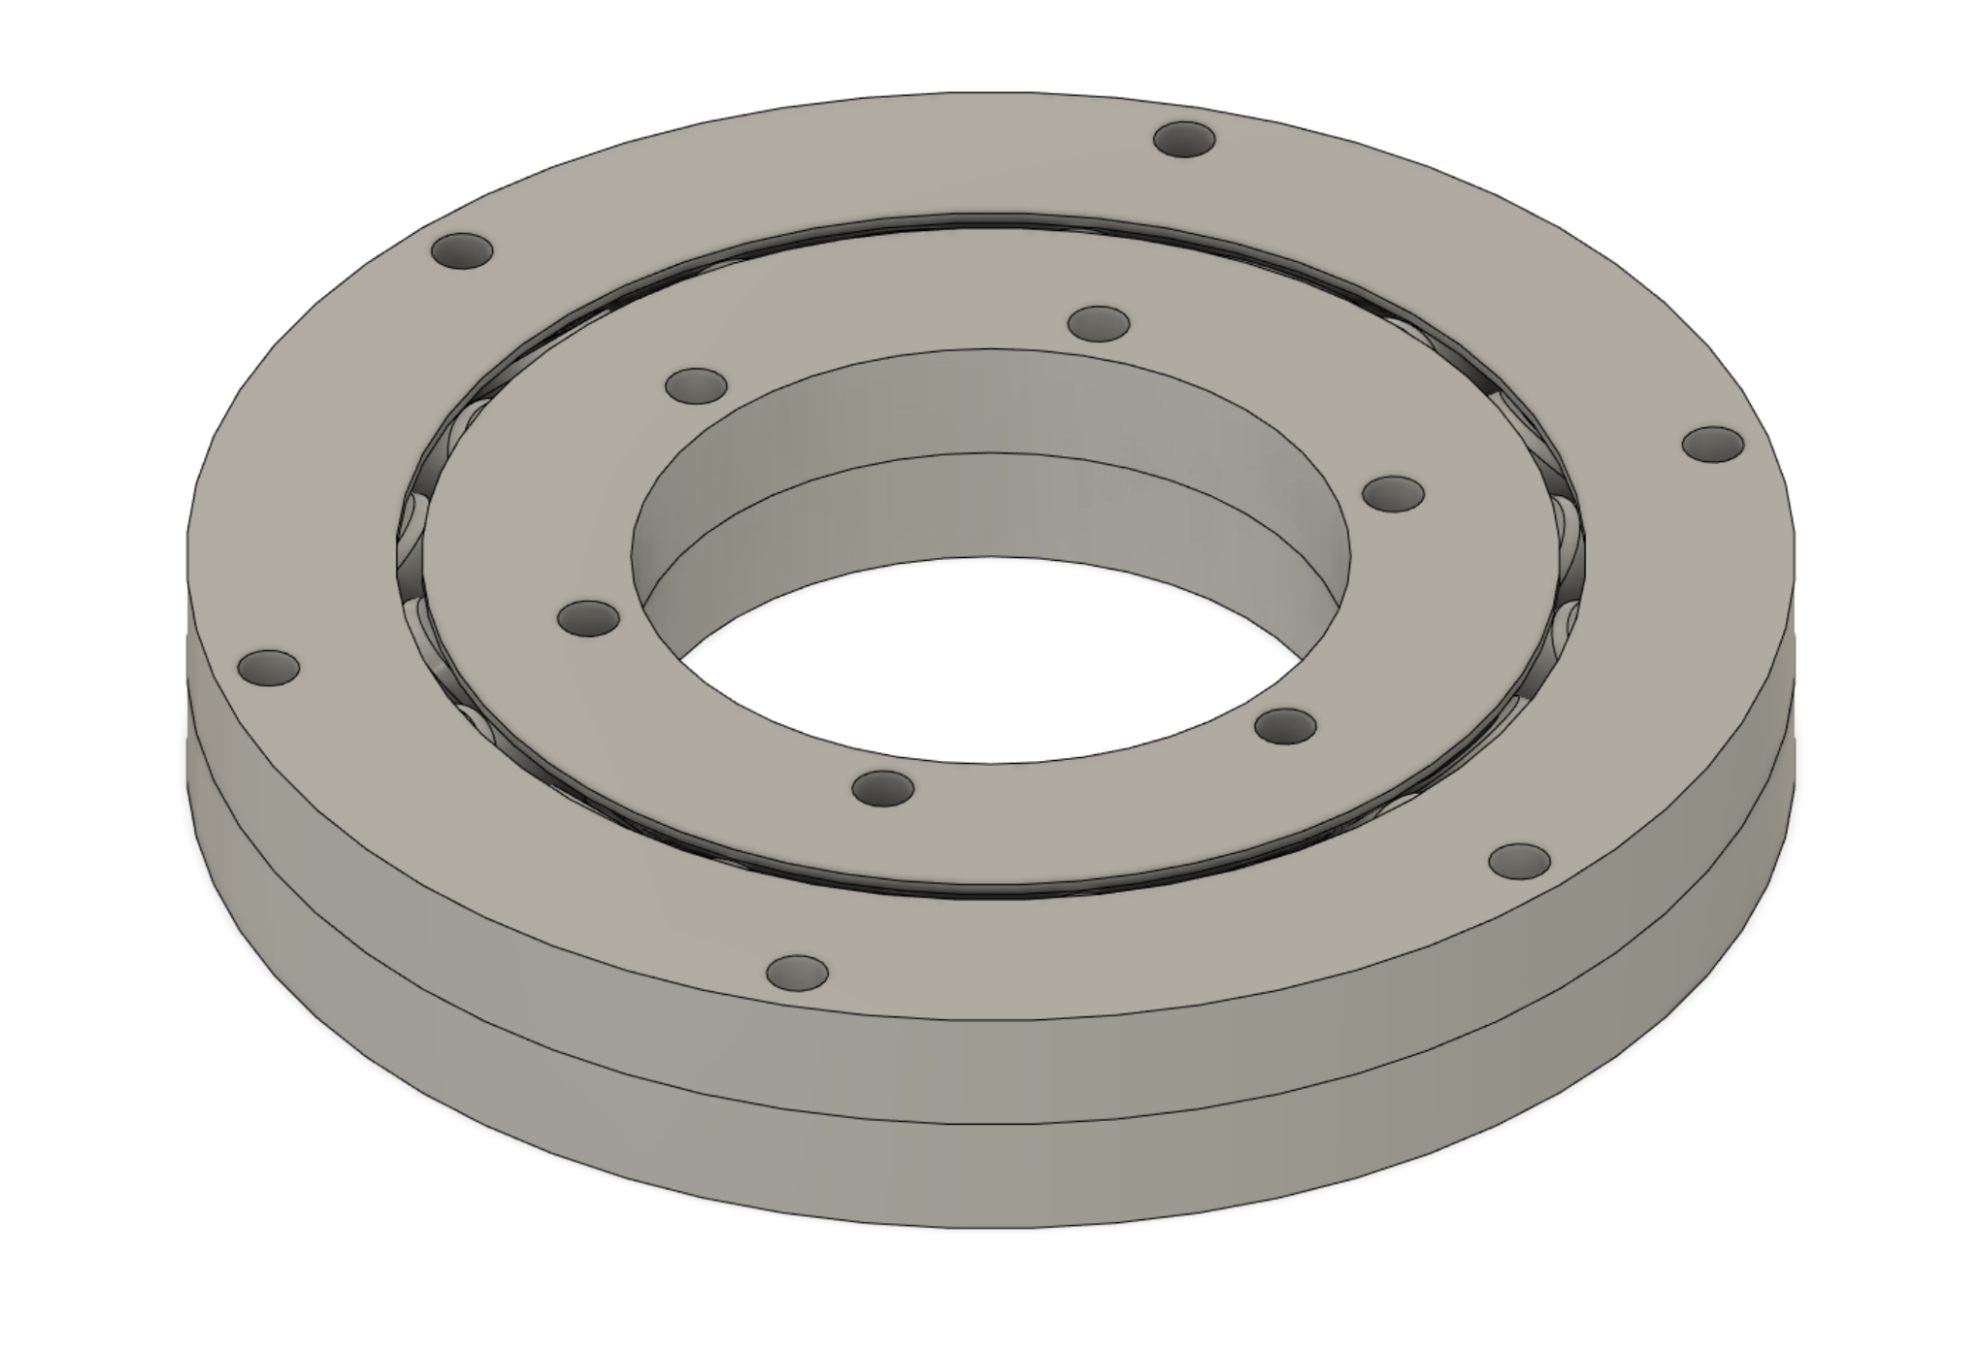
Turntable Base
Nick
Responsible for rotation
Base of arm screws into driven gear
Utilizes a gear train
Utilizes a slew bearing
Screws into table
Outer Ring
Bearings
Inner Ring

Slide 5
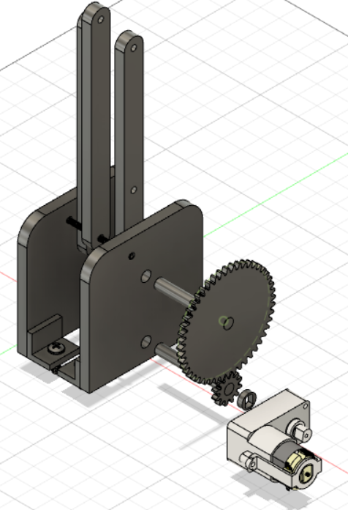
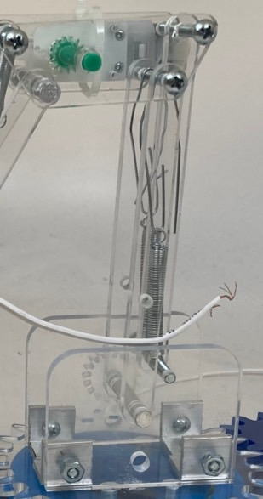
Lower Arm Extends
Bill
Responsible for extension.
Screws into rotating gear.
Lower arm linkages
Side plates
Big gear
Small gear
Motor
Shafts
Motor hub
L Brackets

Slide 6
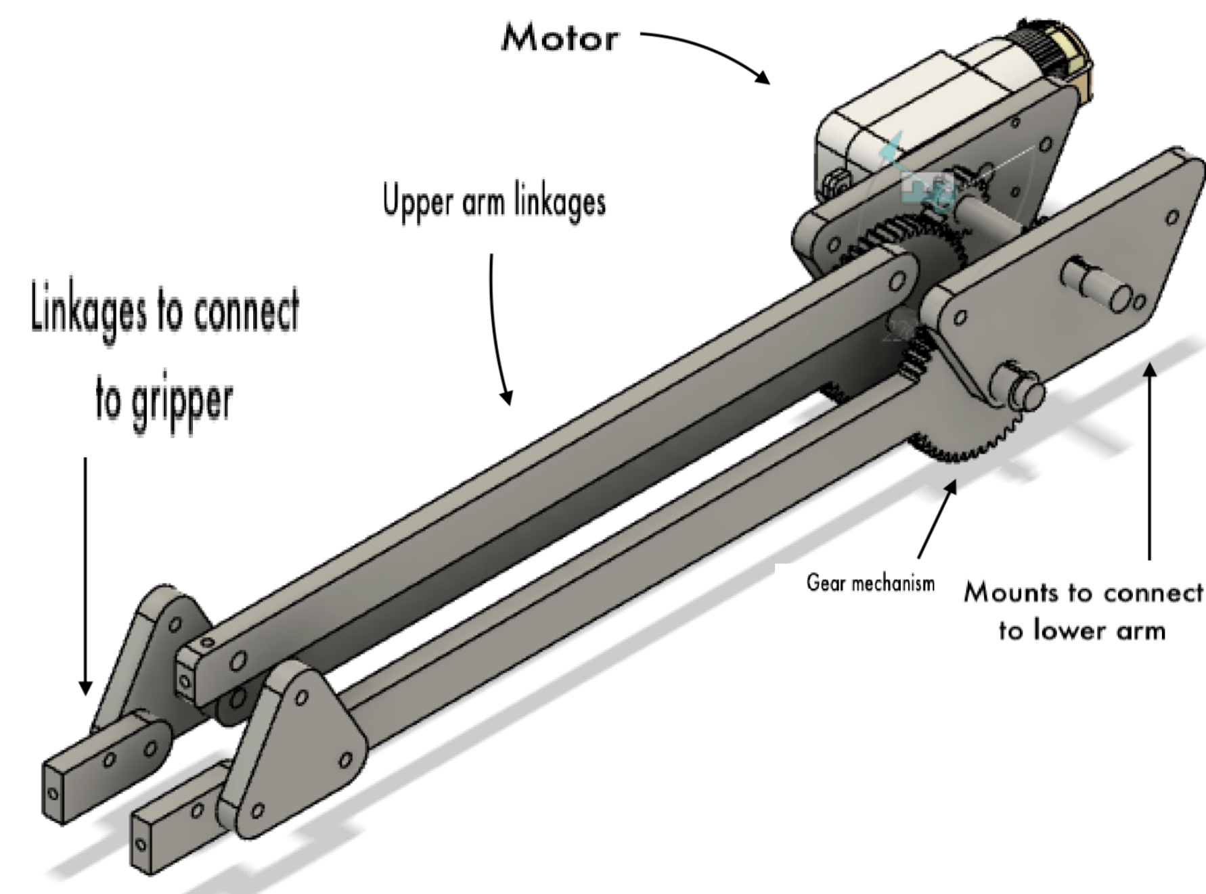
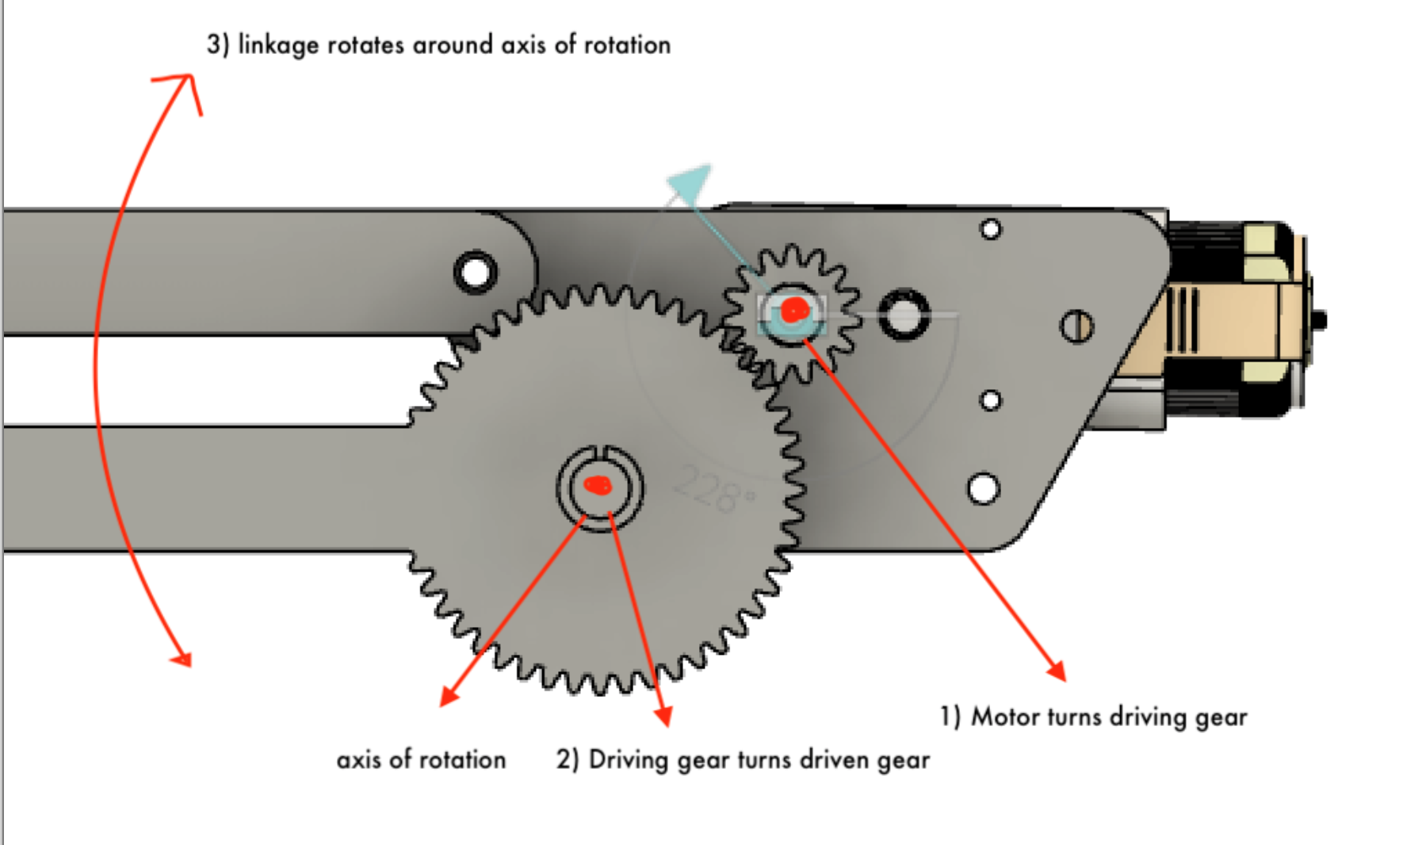
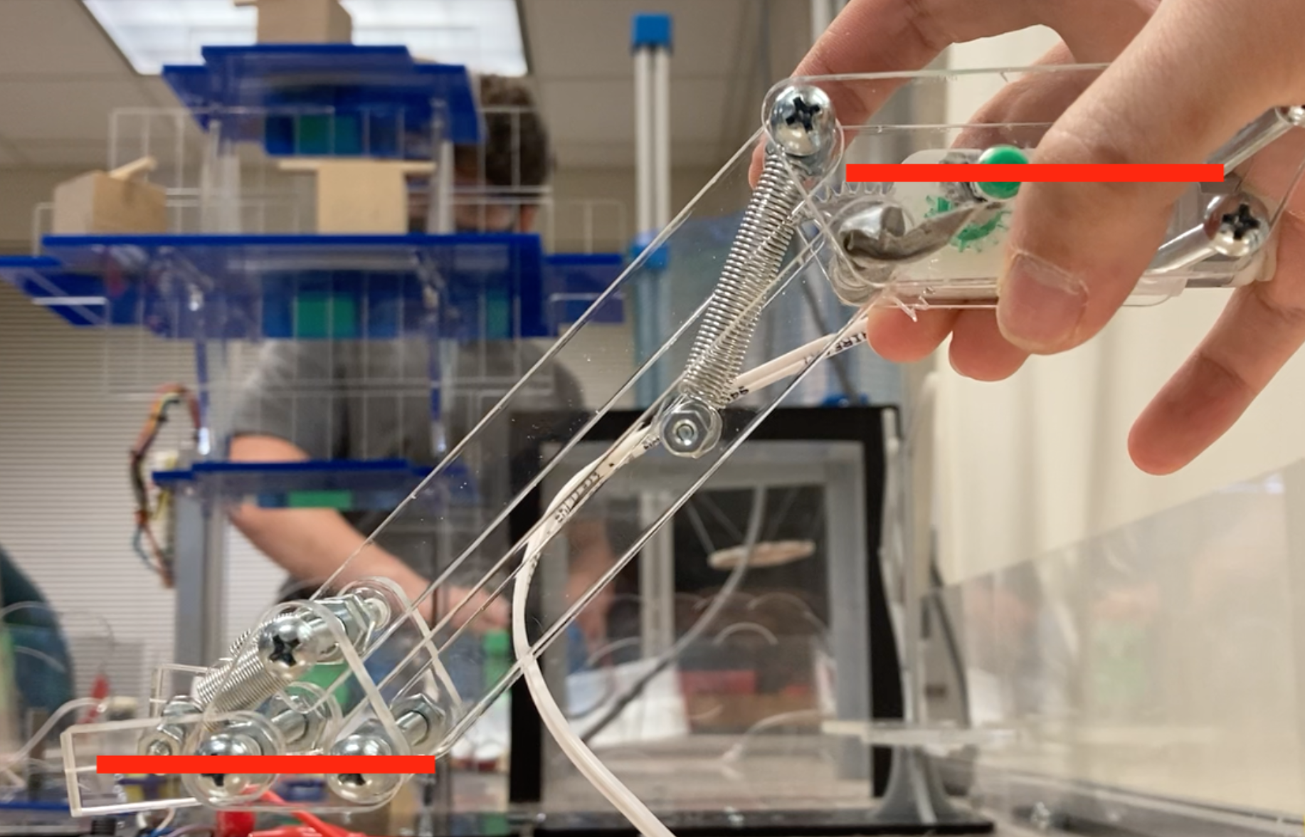
Upper Arm Extends Further
Roger
Extension of the lower arm
Uses four-bar linkage mechanism to ensure level gripper
Notes:
Design decision = lamp arm at home + cardboard prototype

Slide 7
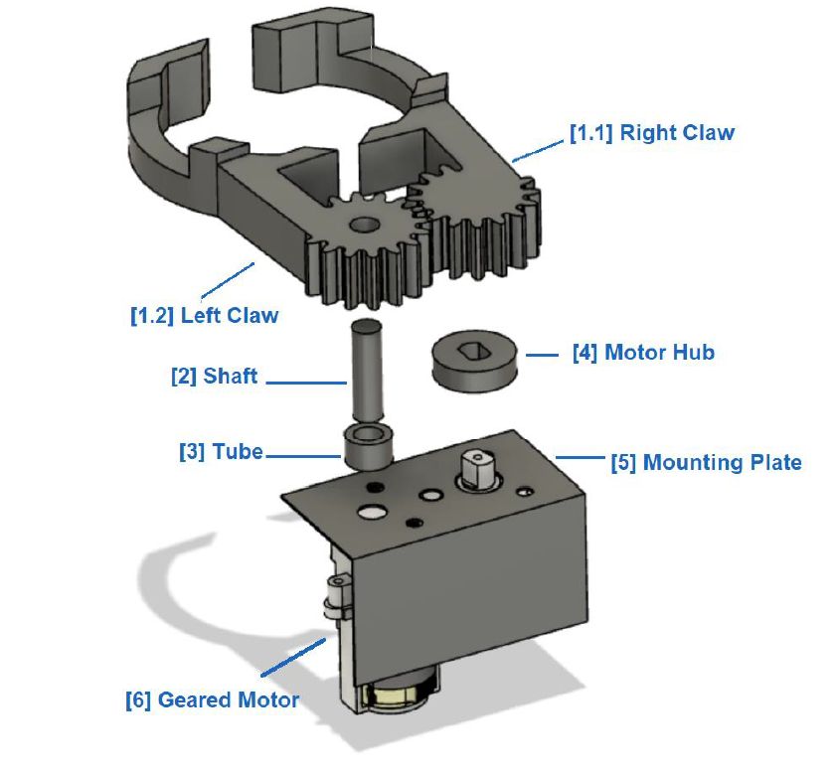
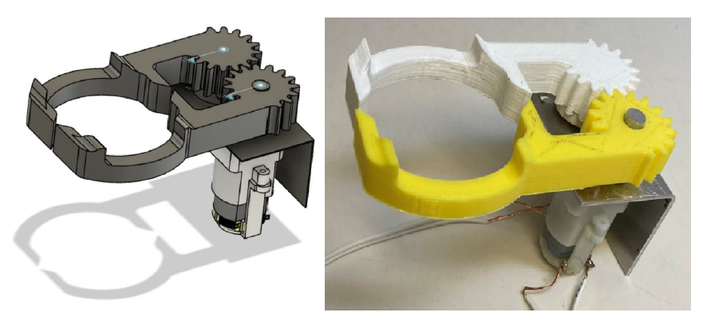
Gripper Grabs Box
Minh
• Actuation method: mechanical grasping.
• Power source: DC geared motor.
• Fabrication materials: PLA, metal sheet, aluminum rod.

Slide 8
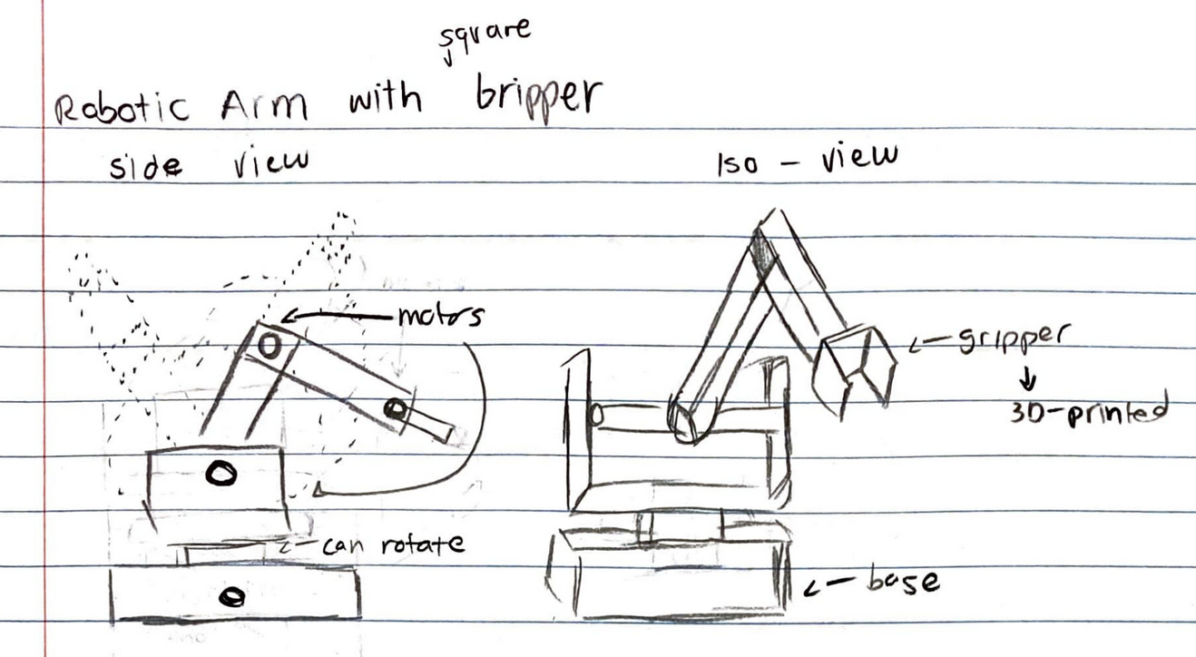
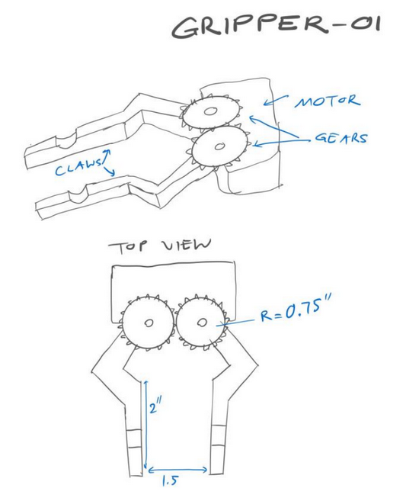
Importance of Initial Sketches
Minh
Initial sketching is an important step in the design process. Our initial idea was to create a robot arm which rotates around a base. The arm will have a gripper to grab the box.

Slide 9
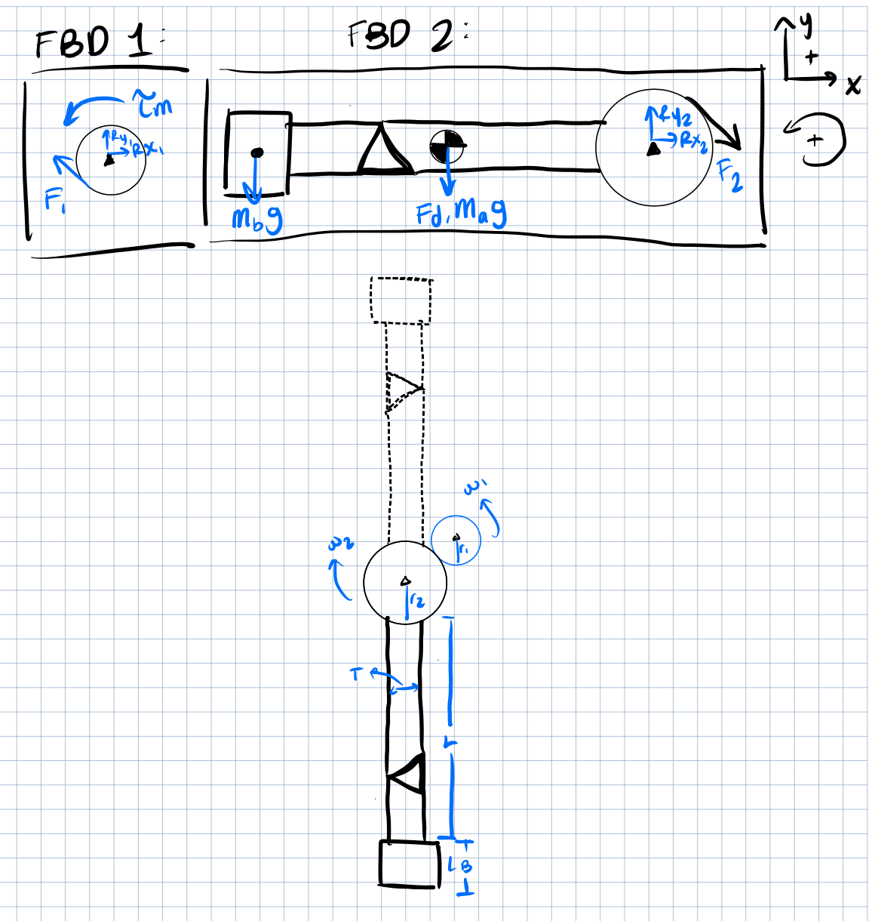
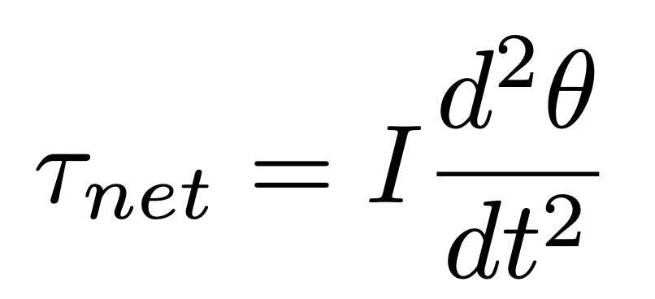
Speed Analysis of Upper Arm
Minh
Roger
Objective: find the maximum angular velocity
Some Assumptions:
Motor operates at no-stall torque (optimistic)
Linkages can be reduced to rectangular prism since they are symmetric along the midplane of the upper joint (conservative)

Slide 10
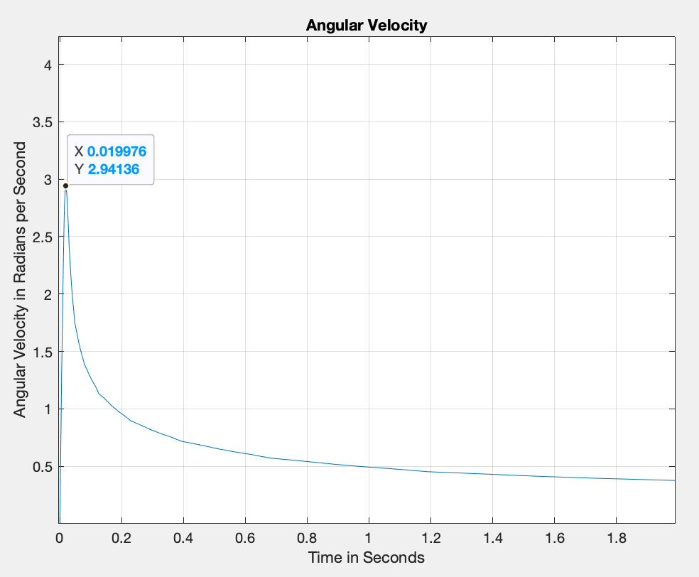
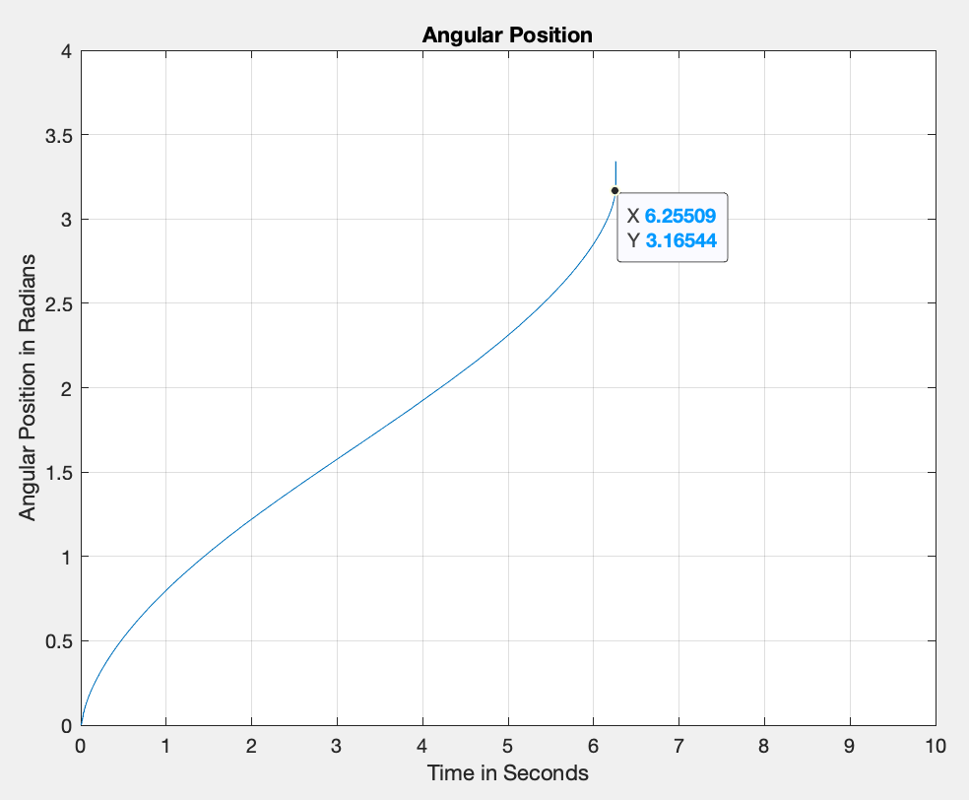
Speed Analysis Cont.
Bill
Nick
Calculated Values:
6.3 seconds for 180 degree rotation
maximum instantaneous angular velocity = 2.94 rad/s
average angular velocity = 0.5067 rad/s
Experimental Values:
3.7 seconds for 180 degree rotation
average angular velocity = 1.357 rad/s
Percent Error (respect to instant): 117%
Percent Error (respect to average): 167%
Factor of Safety: 3.46
Potential Sources of Error:
Human error
Rigid body too conservative
Notes:
Relevance for time = affects competition (perform 180 degree rotation to get from floor to upper floor)
Relevance for speed = maximum performance of robot (directly affects time value)

Slide 11
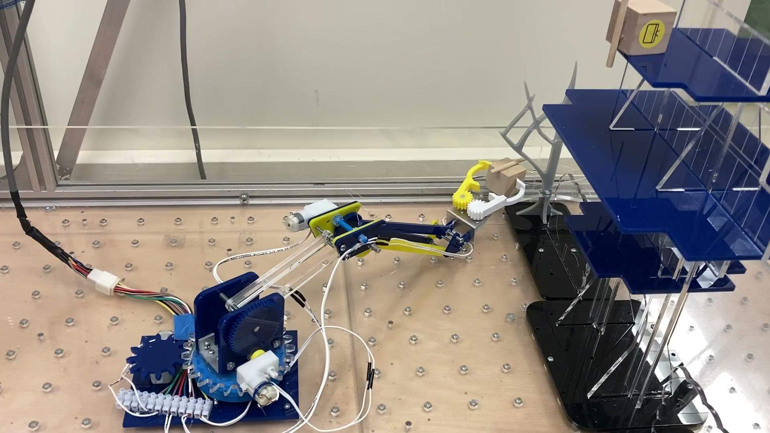
Robot in Action
Bill
Our robot was able to score 70 points (2 boxes on the Top and Second floor) in 60s on its second attempt

